Slide 1
Madrid cpp 004

Slide 2
How it works
API Call parameters
JSON
Serialization
Request through socket
Process results
C++ Objects
Parsing
Get response through socket

Slide 3
How to use

Slide 4
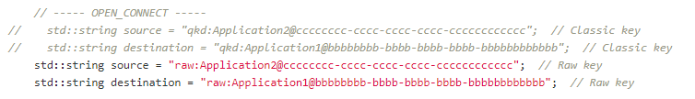
Declare the source and target uri
01 ,01 ,11 ,10 === 01 , 01, 11 ,10
0X,0X ,X1,X0 === 00 , 00, 11, 01
Rand(seed) ←--→ Rand(seed)
qkd
raw
qokd
Rand(seed) ←--→ Rand(seed) XOR one(BER)
Rand_0 & Rand_1 ←--→ Rand_X & X
Números tem que ser par
Não é simétrico (key stream ID é usado pela Alice)

Slide 5
Declare QoS

Slide 6
Open_connect

Slide 7
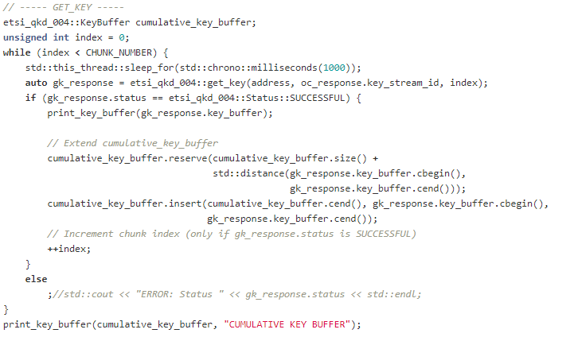
Get_key

Slide 8

close

